Slide 1
2016 State Qualifiers Contest Retail ID

Slide 2
Lamb, Various, Shank, M

Slide 3
Lamb, Breast, Denver Style Ribs, D/M

Slide 4
Pork, Various, Hocks, M

Slide 5
Beef, Loin, Top Loin Steak, D

Slide 6
Pork, Shoulder, Arm Steak, D/M

Slide 7
Lamb, Leg, Sirloin Chop, D

Slide 8
Pork, Loin, Smoked/Cured Rib Chop, D

Slide 9
Pork, Loin, Blade Chop, D/M

Slide 10
Pork, Side/Belly, Slab Bacon, D

Slide 11
Pork, Variety, Heart, D/M

Slide 12
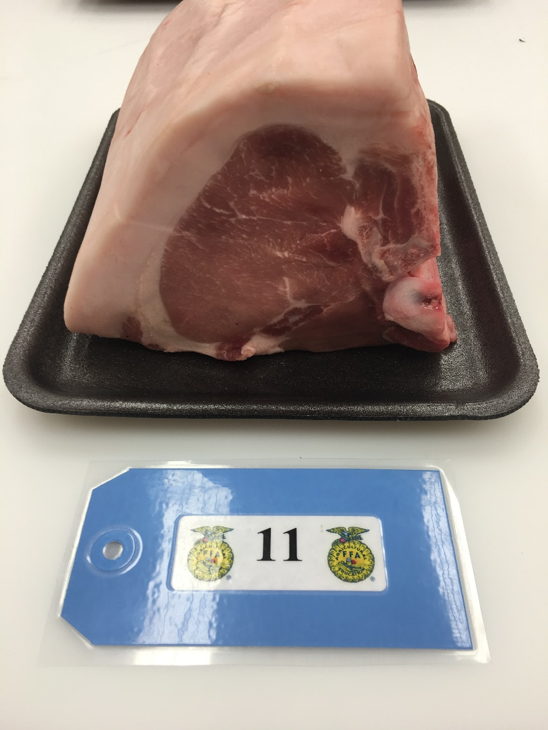
Pork, Loin, Center Loin Roast, D

Slide 13
Beef, Round, Eye of Round Roast, D/M

Slide 14
Pork, Loin, Sirloin Cutlets, D

Slide 15
Pork ,Ham/Leg, Centerslice, D/M

Slide 16
Beef, Chuck, Petite Tender, D

Slide 17
Beef, Round, Tip Roast, D/M

Slide 18
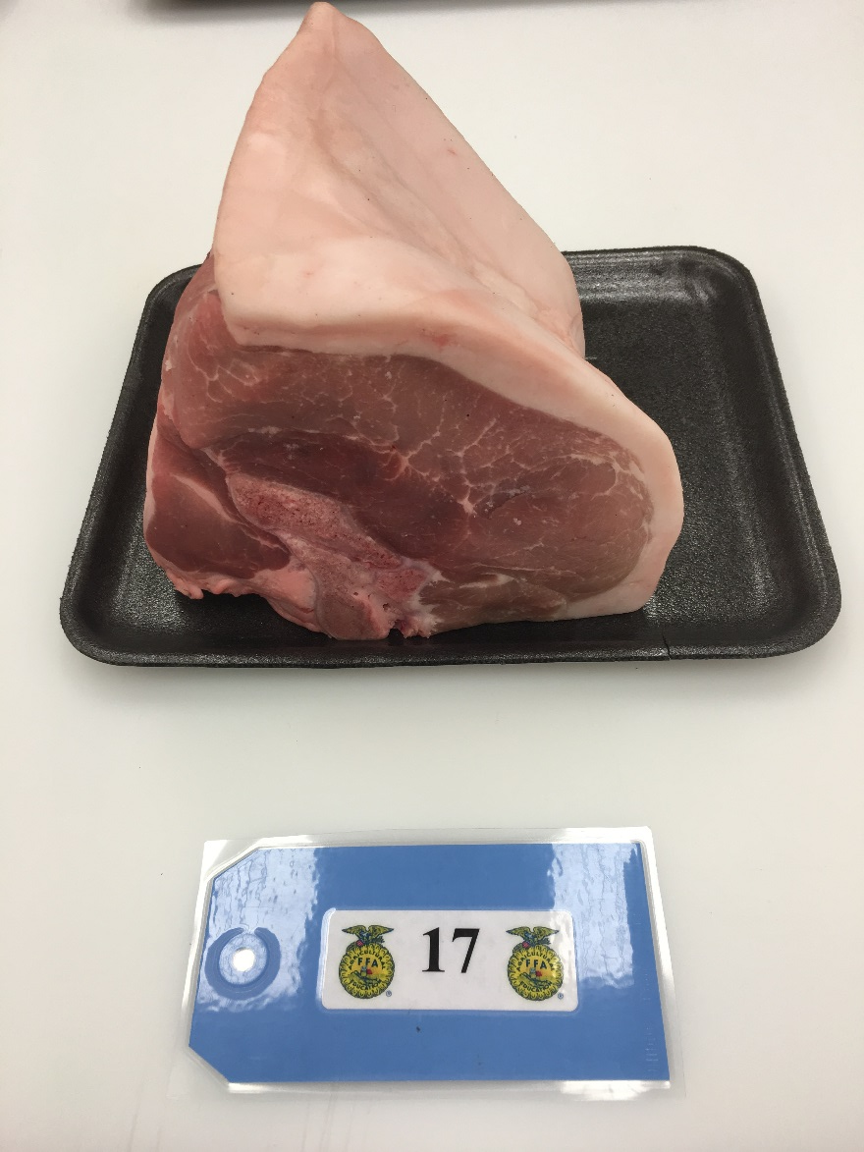
Pork, Loin, Sirloin Roast, D

Slide 19
Lamb, Loin, Loin, Chop, D

Slide 20
Beef, Variety, Oxtail, M

Slide 21
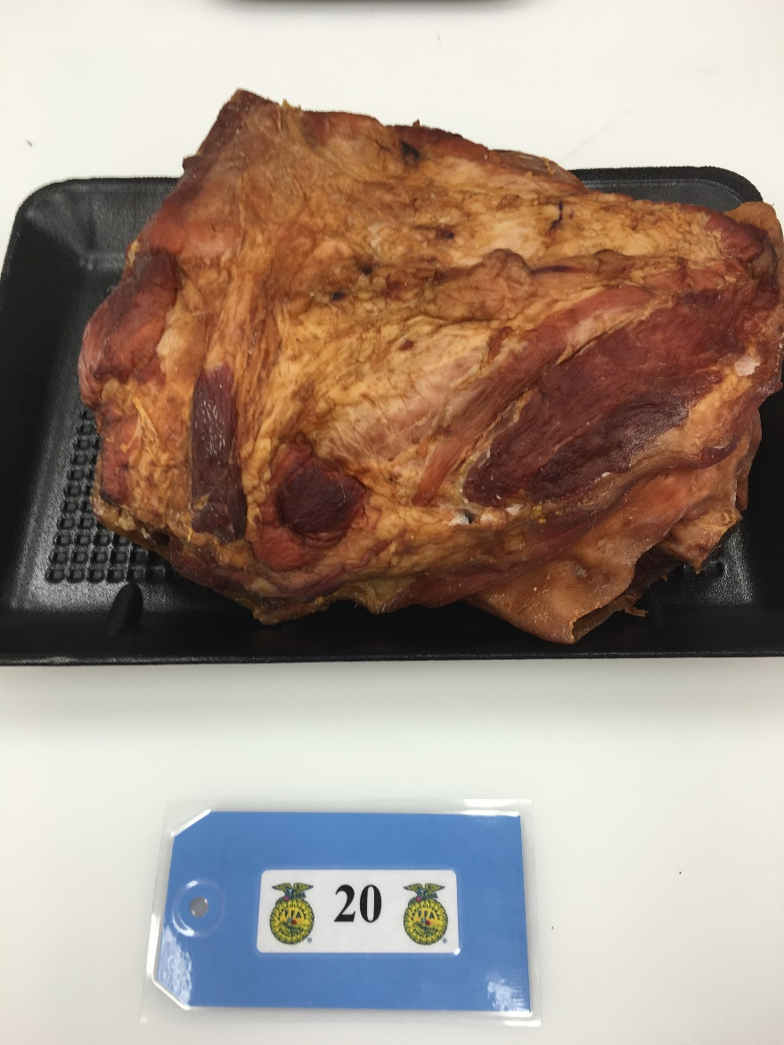
Pork, Shoulder, Smoked Arm Picnic, D

Slide 22
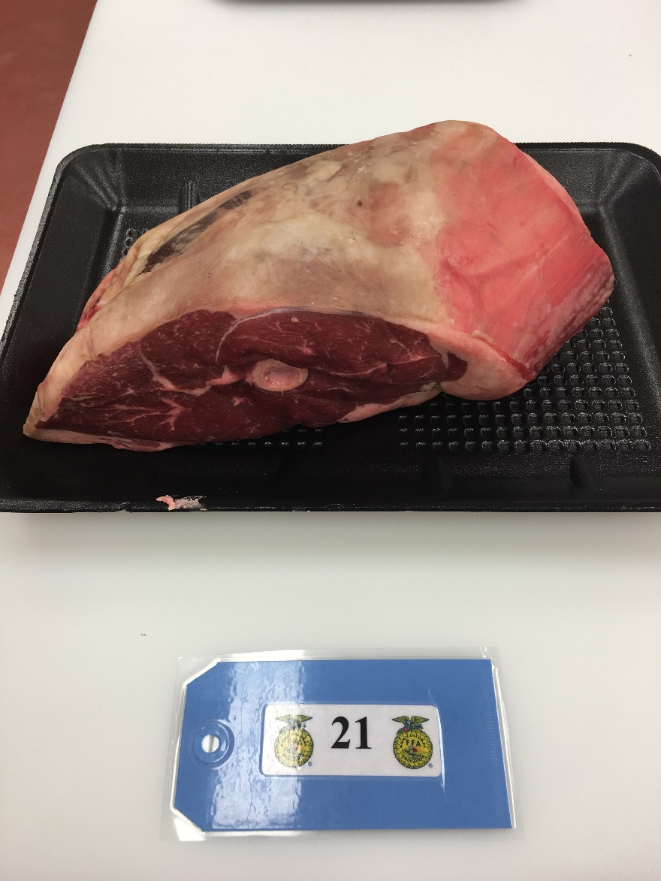
Lamb, Leg, Sirloin Half, D

Slide 23
Beef, Chuck, Top Blade/Flat Iron Steak, D

Slide 24
Pork, Shoulder, Blade Boston, D/M

Slide 25
Beef, Loin, Tenderloin Roast, D

Slide 26
Pork, Ham/Leg, Top Roast, D

Slide 27
Pork, Variety, Liver, D/M

Slide 28
Beef, Brisket, Brisket Whole, M

Slide 29
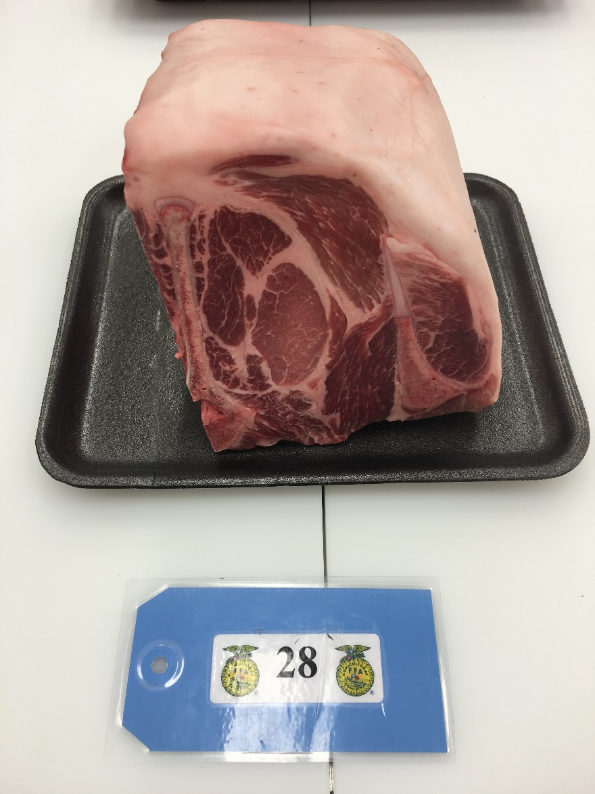
Pork, Loin, Blade Roast, D/M

Slide 30
Beef, Rib, Ribeye Steak, D

Slide 31
Lamb, Rib, Rib Roast, D

Slide 32
Lamb, Leg, Frenched Style, D

Slide 33
Beef, Chuck, Mock Tender Roast, M

Slide 34
Pork, Ham/Leg, Shank Portion, D/M

Slide 35
Beef, Loin, Porterhouse Steak, D

Slide 36
Lamb, Rib, Rib Roast Frenched, D

Slide 37
Pork, Ham/Leg, Tip Roast, D

Slide 38
Beef, Loin, Tri-Tip Roast, D

Slide 39
Lamb, Shoulder, Blade Chop, D/M

Slide 40
Beef, Round, Bottom Round Steak, M

Slide 41
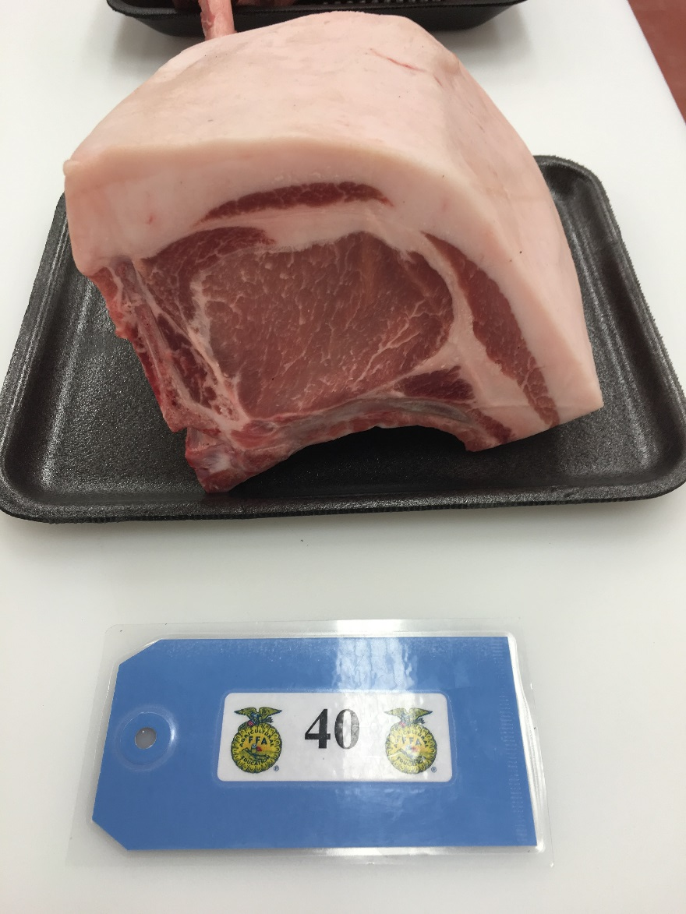
Pork, Loin, Center Rib Roast, D

