Slide 1
2016 State Qualifiers Placing Classes

Slide 2
Beef Carcasses Class 1

Slide 3
1.

Slide 4
2.

Slide 5
3.

Slide 6
4.

Slide 7
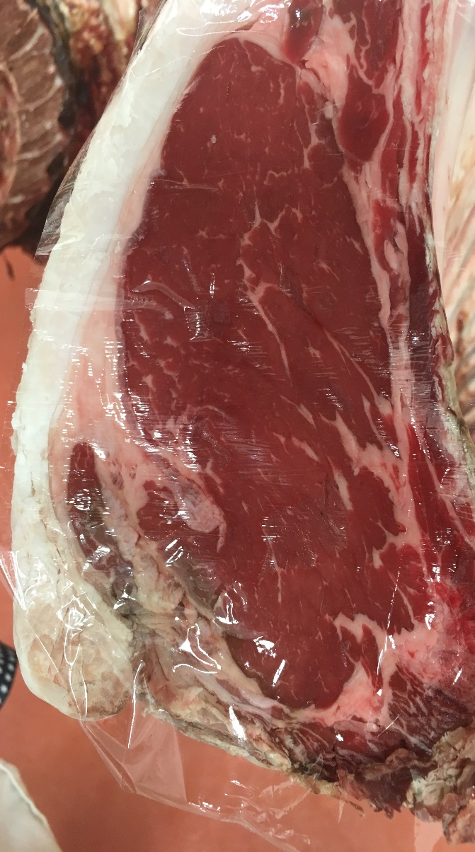
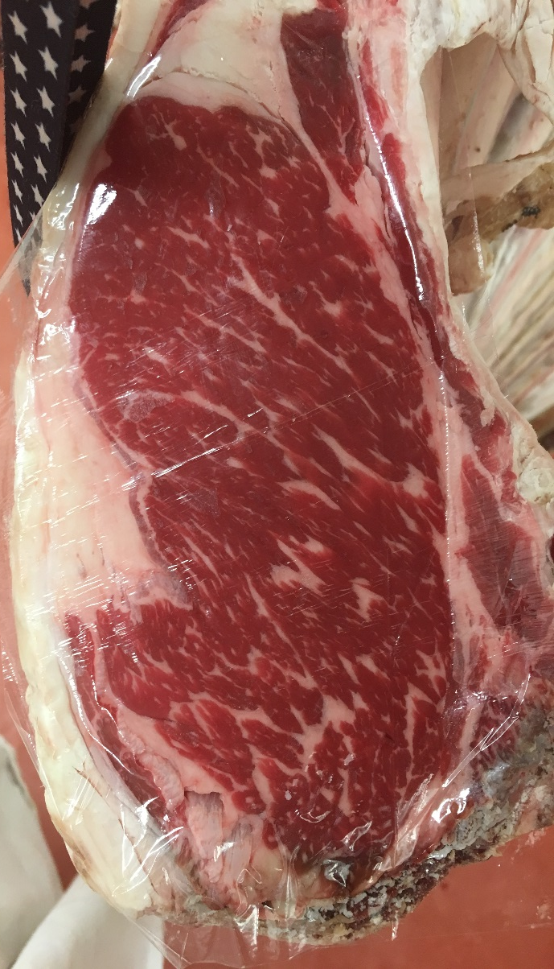
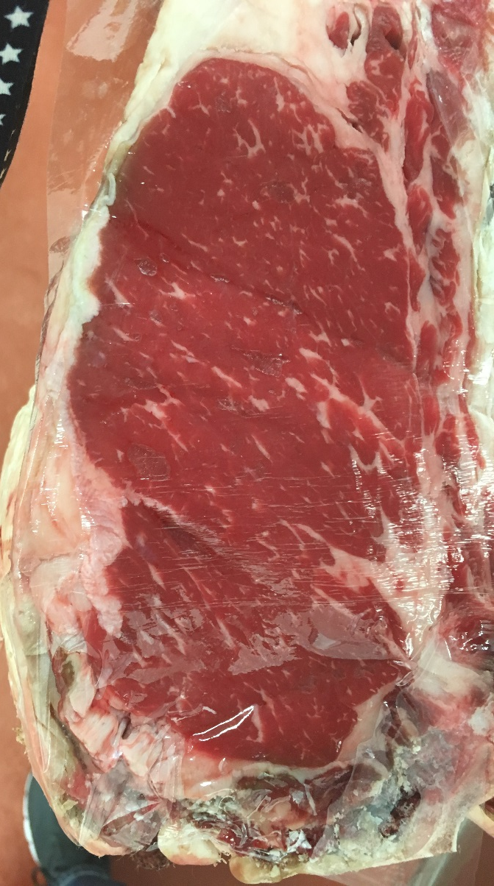
1. 2. 3. 4.

Slide 9
Questions
Between 1 and 2 which carcass had less fat opposite the ribeye?
How many carcasses do NOT grade USDA Choice?
Which carcass was trimmest opposite the ribeye?
Between 3&4, which beef carcass had a heavier muscled round?
Which beef carcass possessed the highest degree of marbling?

Slide 10
Officials
Placing- 3,4,1,2
Cuts: 6-5-3
Questions
1. | 1
2. | 1
3. | 4
4. | 3
5. | 3
CX # | QG | PYG | REA | HCW | KPH | YG
1 | Ch- | 3.5 | 13.6 | 850 | 3.0% | 3.5
2 | Ch- | 4.0 | 11.0 | 850 | 2.0% | 4.7
3 | Pr- | 3.0 | 14.1 | 850 | 1.0% | 2.5
4 | Ch- | 2.4 | 14.4 | 850 | 1.0% | 1.8

Slide 11
Pork Carcass Class 2

Slide 12
1.

Slide 13
2.

Slide 14
3.

Slide 15
4.

Slide 16
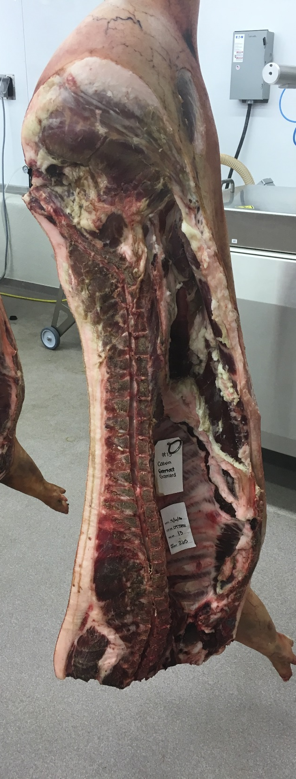

Slide 18
Questions
Which pork carcass had the most fat over the collar?
Between 2 and 3 which pork carcass was heavier muscled, with the thicker, plumper cushioned ham?
Which pork carcass displayed the most fat opposite the first rib?
Between 1 and 4 which carcass displayed a thicker, more bulging shoulder?
Which pork carcass had the least area of exposed lean in the lumbar region?

Slide 19
Officials
Placing- 3,2,4,1
Cuts: 3-7-4
Questions
1. | 1
2. | 3
3. | 1
4. | 4
5. | 3

Slide 20
Lamb Carcass Class 3

Slide 26
Questions
Which carcass would yield the highest percentage of closely trimmed retail cuts?
Between 2 and 3 which carcass had a fuller, more prominent sirloin?
Which carcass had the lightest muscled shoulder?
Which carcass combined trimness and muscling to the lowest degree?
Between 1 and 3 which carcass possessed a heavier muscled, plumper cushioned leg?

Slide 27
Officials
Placing- 4,1,3,2
Cuts: 6-2-6
Questions
1. | 4
2. | 3
3. | 4
4. | 2
5. | 1

Slide 28
Beef Ribs

Slide 29
1.

Slide 30
2.

Slide 31
3.

Slide 32
4.

Slide 33
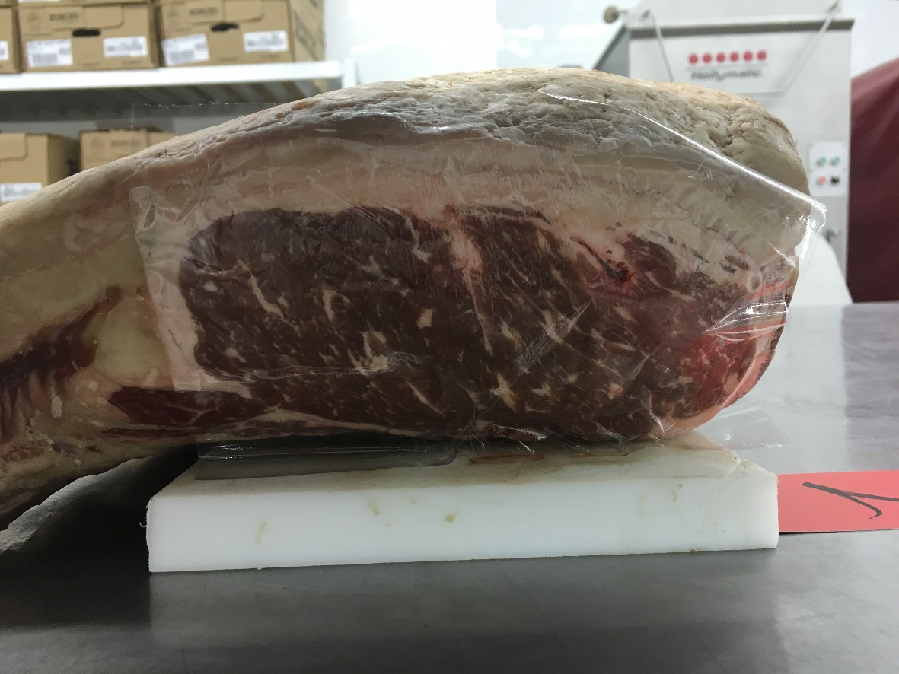
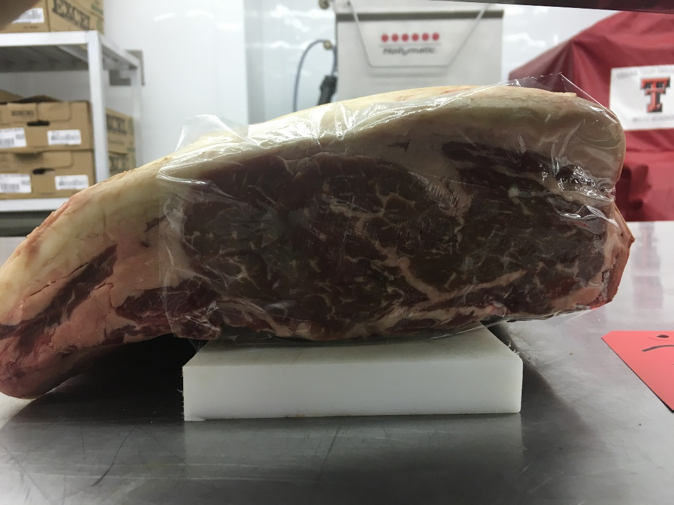
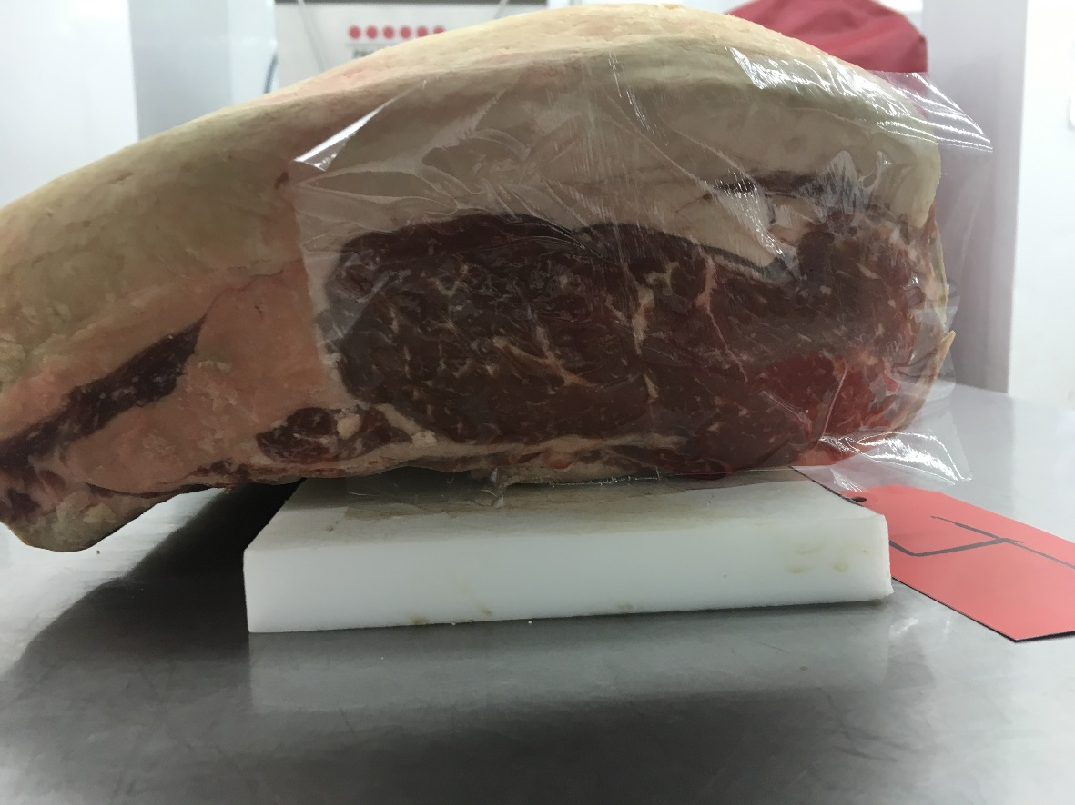
1.
2.
3.
4.

Slide 34
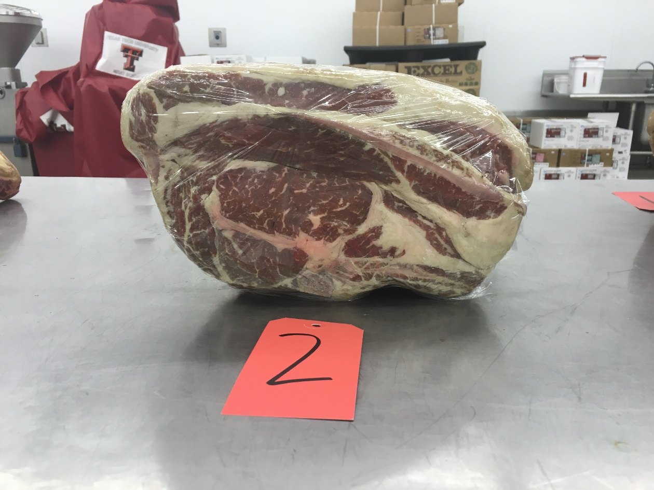
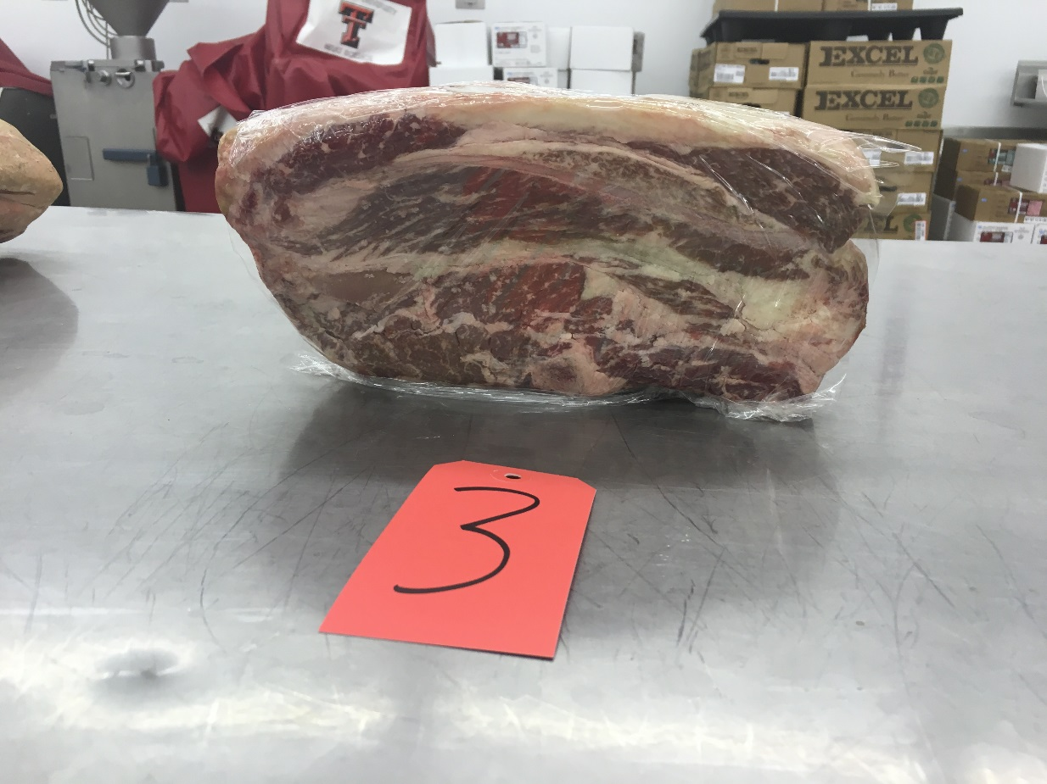
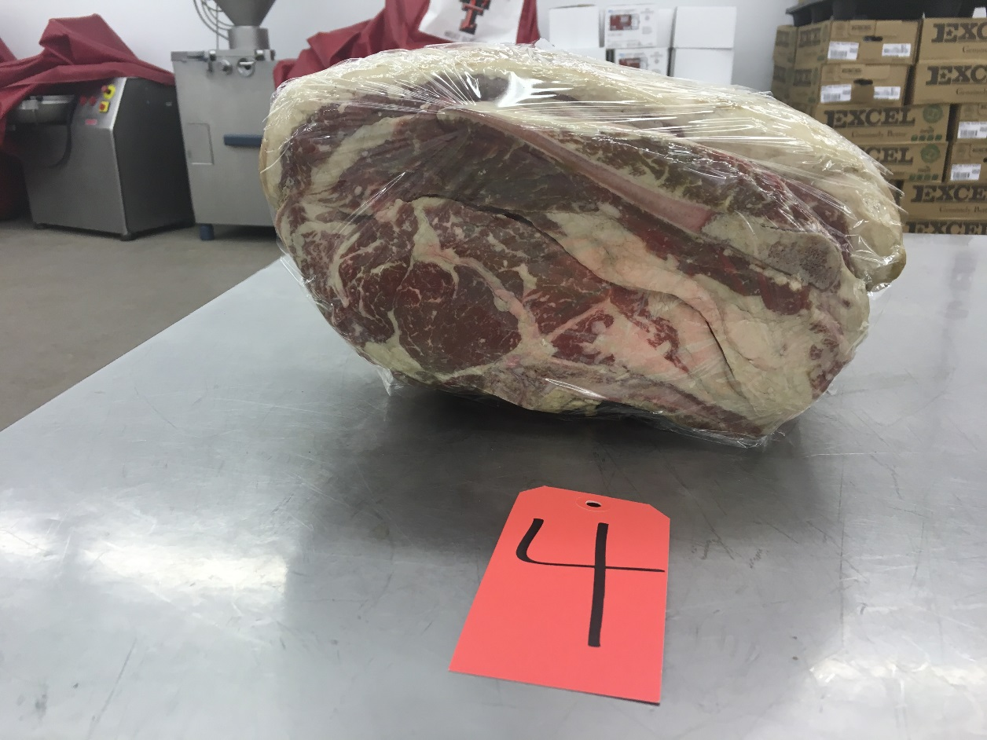
1.
2.
3.
4.

Slide 35
Questions
Which rib had the largest eye of blade in the blade face?
7. Which rib had the least fat opposite the ribeye and over the lower rib?
Which rib possessed the most fat over the blade face especially the upper blade face?
Which rib displayed the darkest colored blade face?
Which rib was the fattest, wastiest, lowest yielding in the class?

Slide 36
Officials
Placing- 3,2,1,4
Cuts: 2-5-7
Questions
1. | 2
2. | 3
3. | 1
4. | 1
5. | 4

Slide 37
Pork Hams

Slide 38
1.

Slide 39
2.

Slide 40
3.

Slide 41
4.

Slide 42
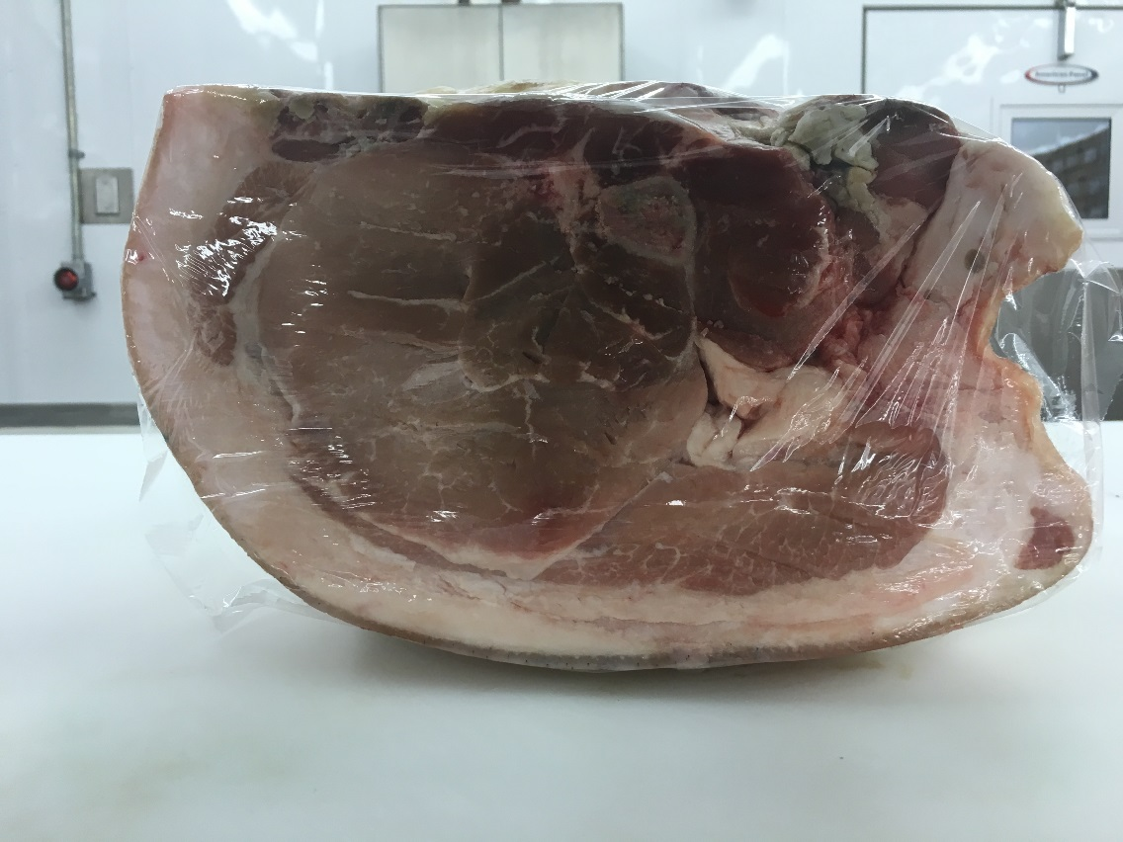
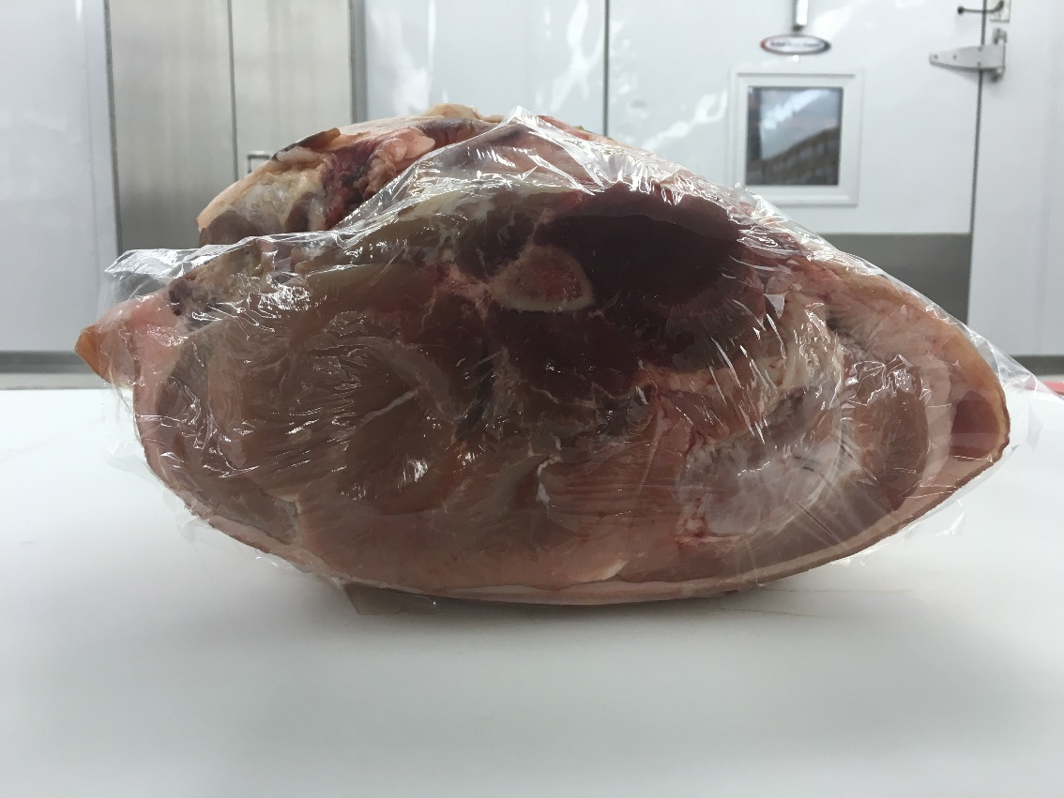
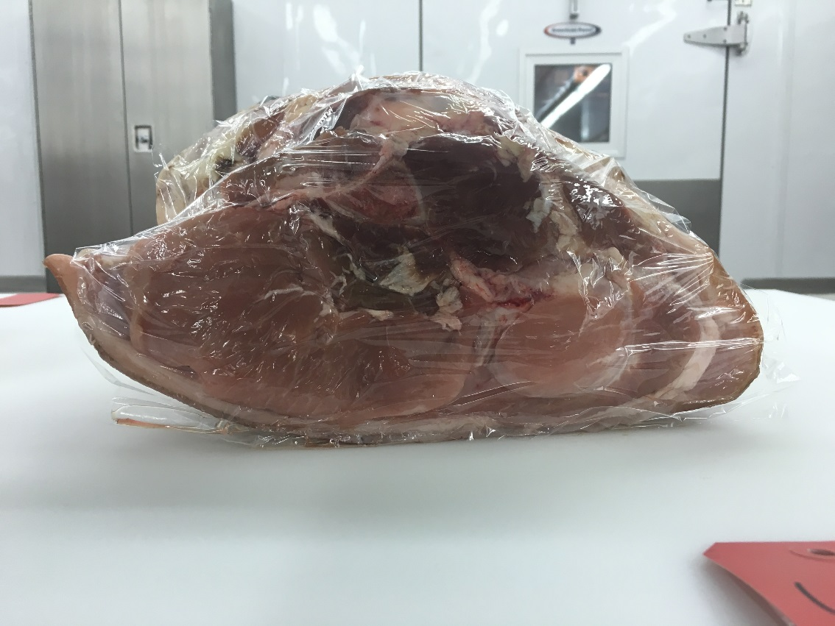
1.
2.
3.
4.

Slide 43
1.
2.
3.
4.

Slide 44
Questions
Between 2 and 3 which ham possessed a firmer buttface?
Which ham possessed the smallest forecushion?
Between 3 and 4 which ham possessed a greater are of exposed lean in the buttface?
Which ham exhibited the widest center section?
Which ham was the trimmest over the forecushion?

Slide 45
Officials
Placing- 3,4,1,2
Cuts: 2-7-2
Questions
1. | 2
2. | 1
3. | 3
4. | 4
5. | 4

Slide 46
Beef Pricing Class

Slide 47
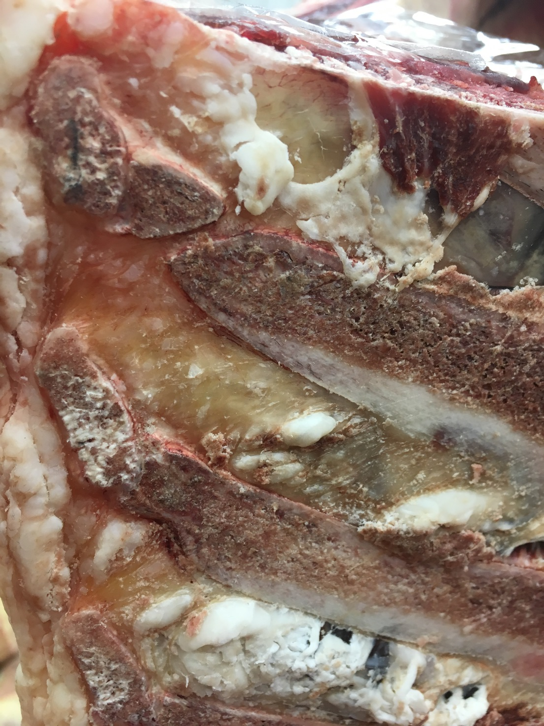
1.

Slide 48
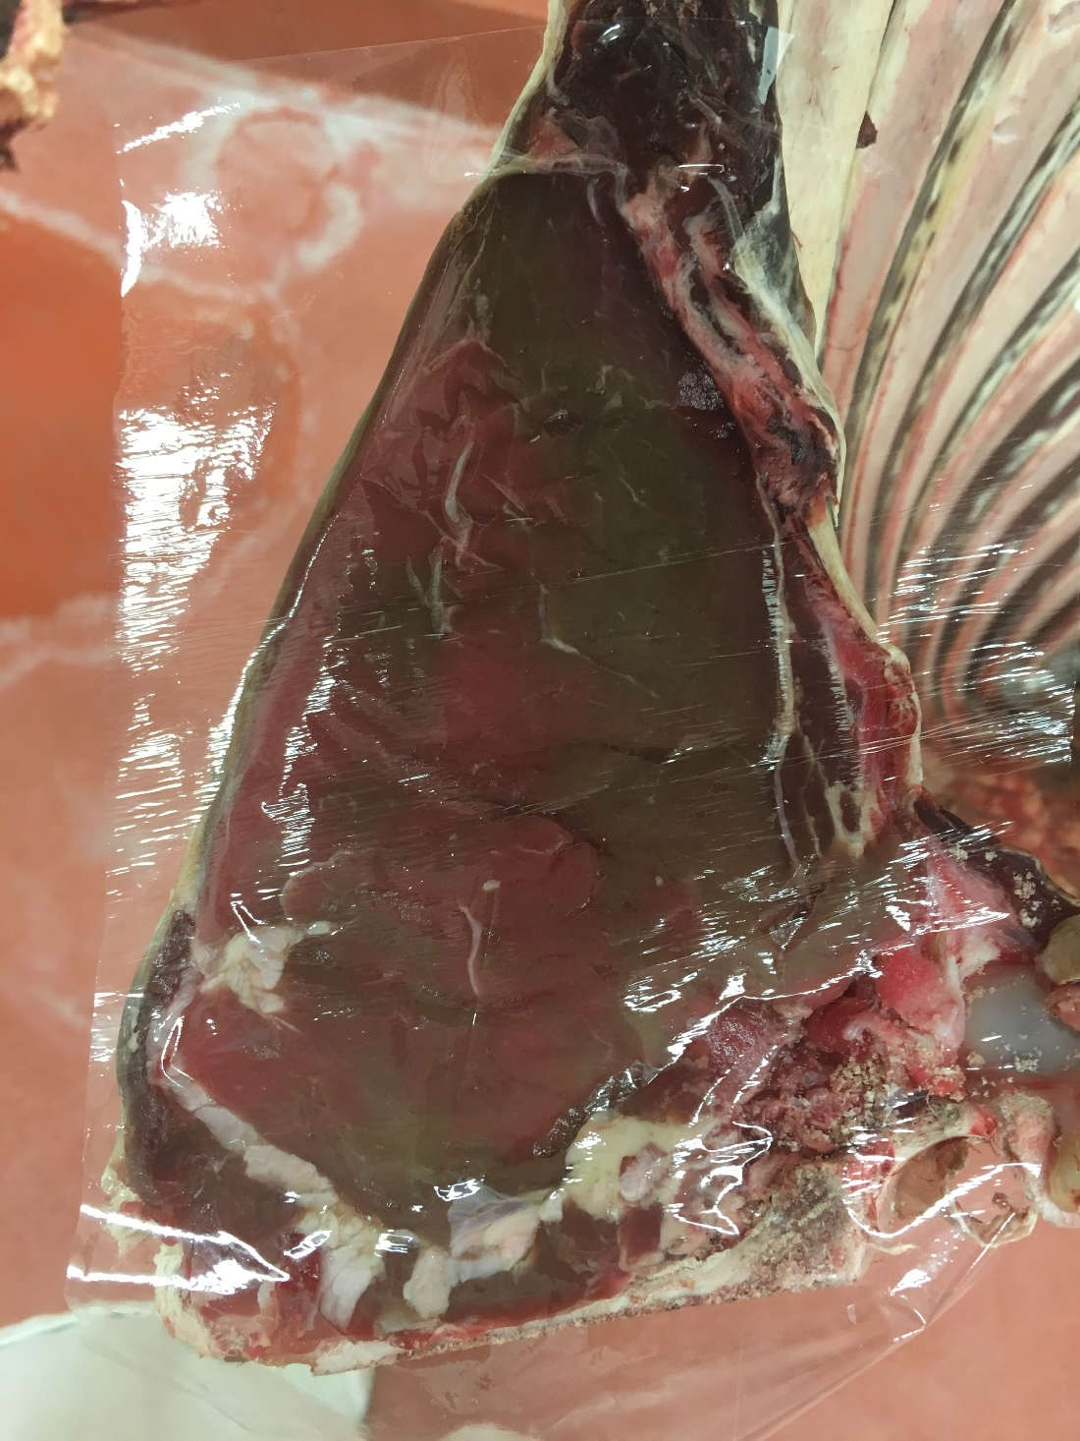
2.

Slide 49
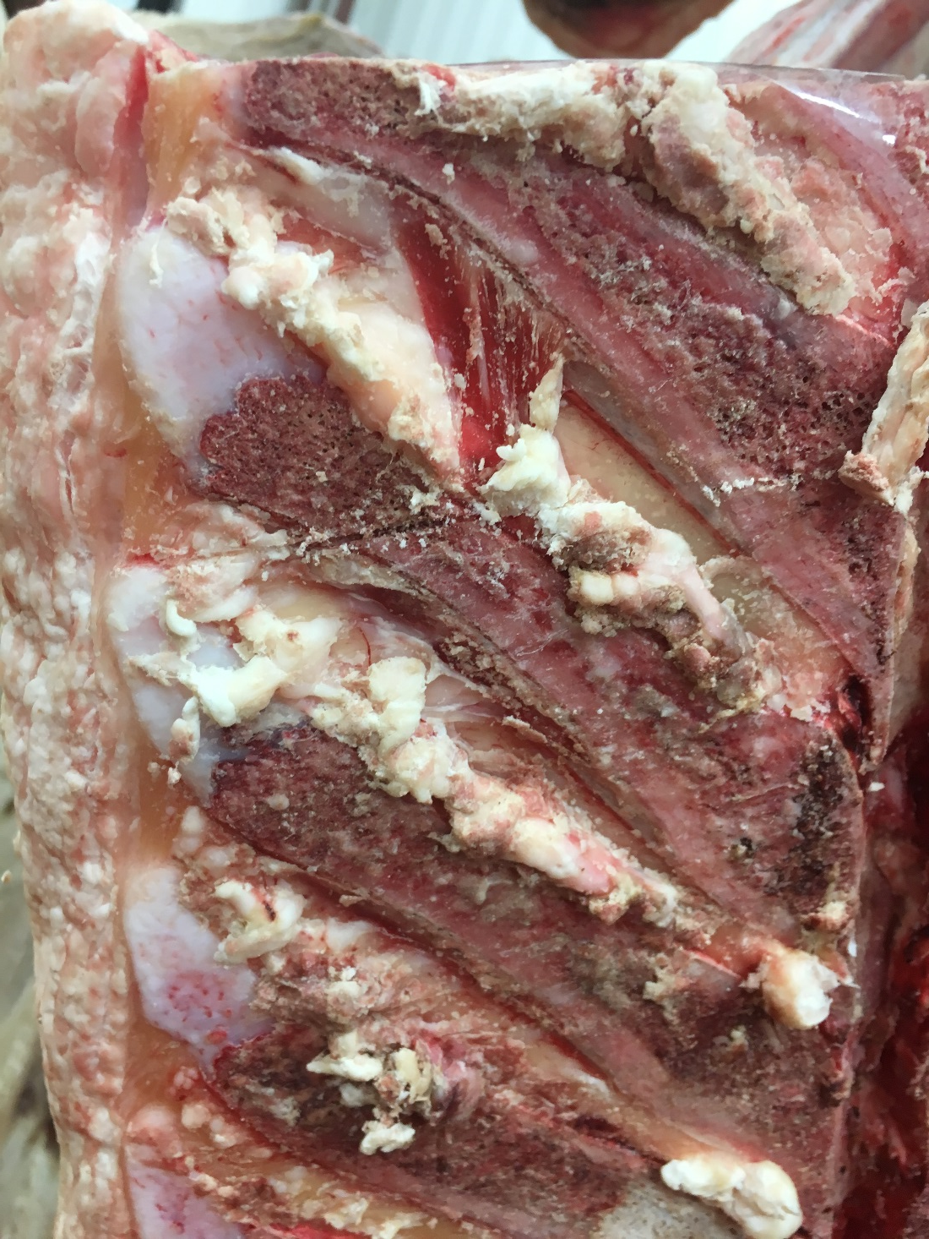
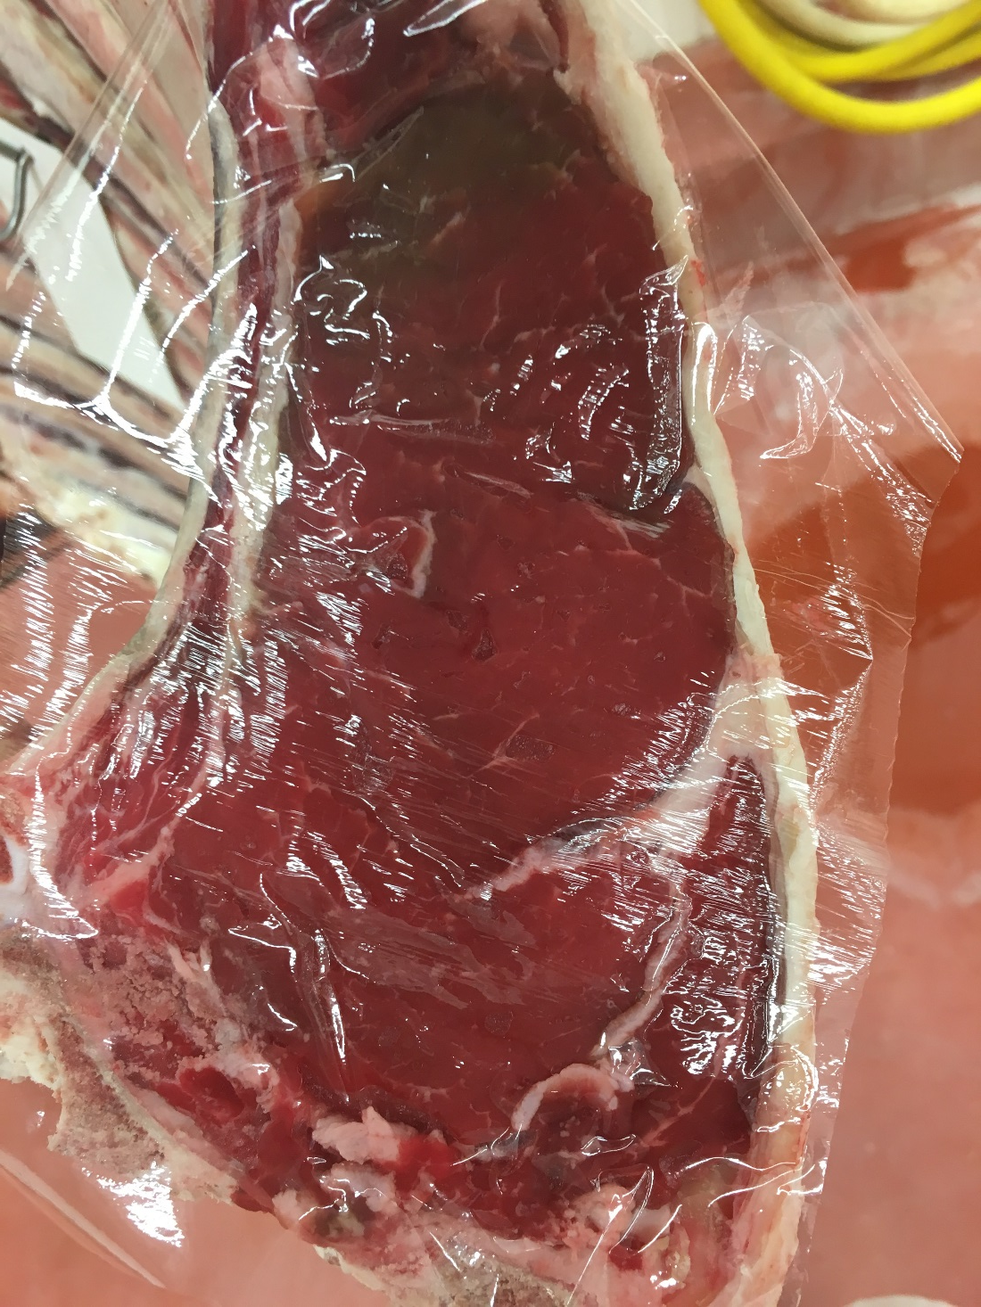
3.

Slide 50
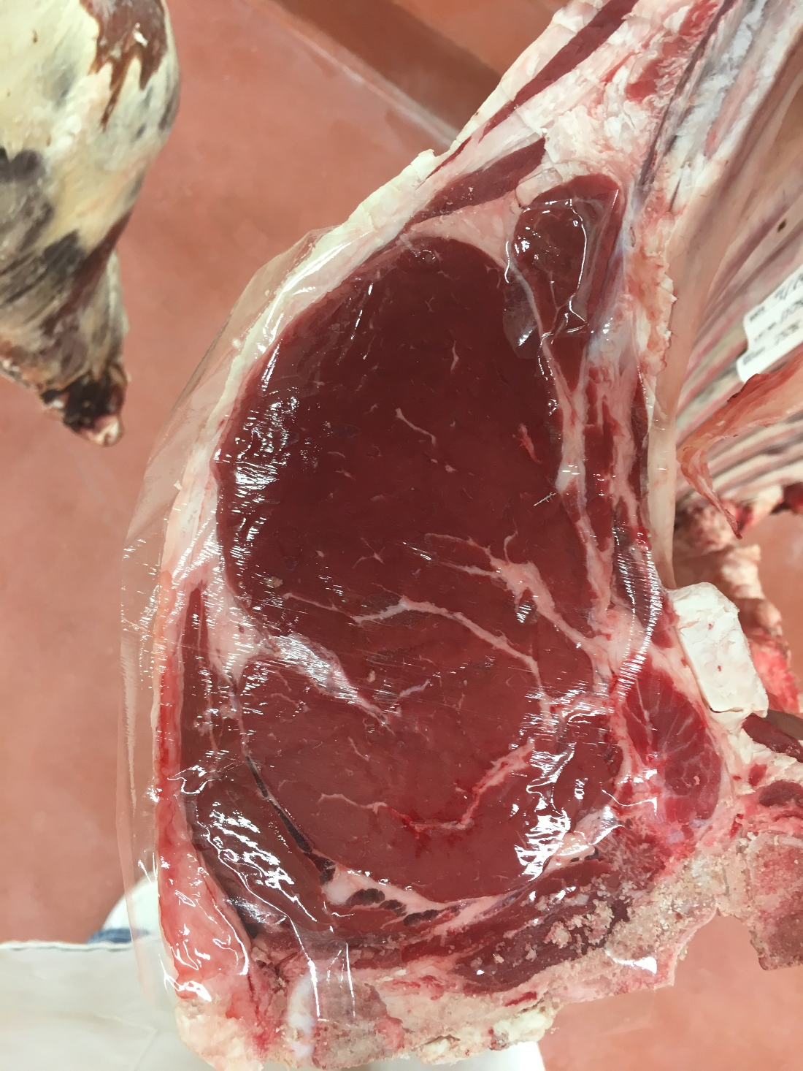
4.

Slide 52
Questions
Which carcass displayed the greatest amount of marbling in the ribeye?
Which carcass possessed the most fat opposite the ribeye?
Which carcass was the heaviest muscled?
Which carcass displayed the least uniformed colored ribeye?
Between 3 and 4 which carcass displayed less fat over the loin?

Slide 53
Officials
Placing- 4,3,2,1
Cuts: 2-5-4
CX # | QG | PYG | REA | HCW | KPH | YG | DEFECT | PRICE
1 | Ut° | 3.5 | 10.8 | 700 | 1.5% | 3.6 | HB | 166$
2 | St+ | 2.0 | 11.1 | 650 | 0.5% | 1.6 |  | 178$
3 | Se- | 2.4 | 11.0 | 720 | 1.5% | 2.5 |  | 193$
4 | Se+ | 2.7 | 15.2 | 750 | 1.5% | 1.5 |  | 195$
Questions
1. | 4
2. | 1
3. | 4
4. | 2
5. | 3

